Slide 1
Canvas page
PDK Libraries :
  Prmitives
    Directional_couplers
    Edge_couplers
      EC_SiN400_1310_1p0dB_L635_A0_QY_202604
    Crossings
    Photodetectors
  Composite
    MZIs
  Electronics
    Resistors
      RES50
    Capacitors
  Personal Libraries (import from SQlite)
X: 0.000
Y: 0.000
Item name: EC_SiN400_1310_1p0dB_L635_A0_QY_202604
Description:
Properties :
  X : (%.3f )
  Y: (%.3f )
  A: (%.3f )
PDK: (string)
Ports:
  a1
  b1
  a2
  B2
Image :
DC
BS
Routing selections:
  Single mode wires
  Multi-mode wires
  DC electrical wires
  RF electrical wires
Function block to be explored
User name : XXXXXX
User ID : 12345678
Log out
Grid lock

Slide 2
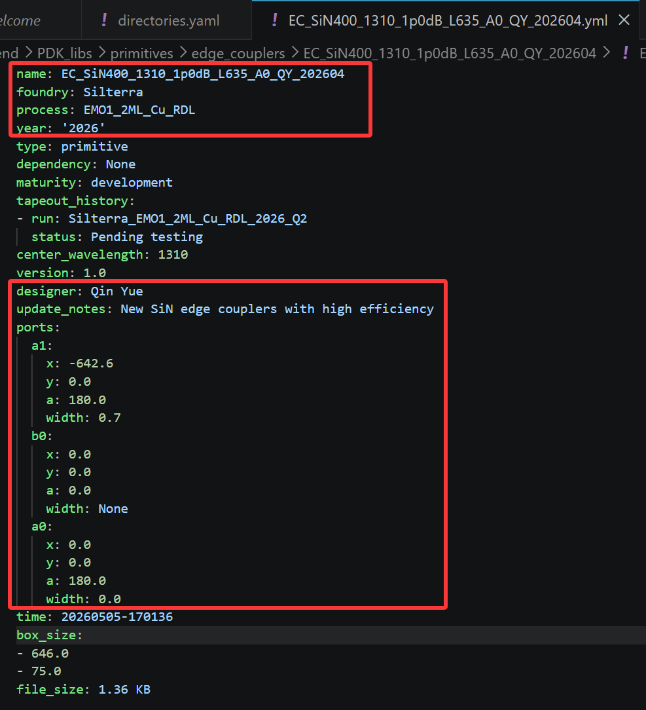

Slide 3
Login Page
User name : xxx
Password : xxxx
Random verification code : xxxx
Option page :
New project
Retrieve project
Library construction.
Canvas page :
SQLite database
GDS generator
Simulator

